Slide 1

Files and Exceptions
Dr. Yasser Aldwyan 1445 A.H. (2023/24)

Slide 2
Outline
Introduction
Files
Text-file processing (reading, writing and updating)
Serialization with JSON
Working with CSV files
Exception handling

Slide 3

Introduction
Temporary vs persistent data storage
Variables, lists, tuples, dictionaries provide only temporary data storage.
E.g., when the program exits, data is lost
Files provides persistent data storage.
They are stored on secondary storage devices, e.g., hard disks, solid-state drives …
Text files have different popular formats, such as
Plain text
JSON (JavaScript Object Notation)
CSV (comma-separated values)

Slide 4
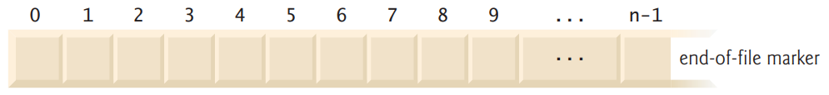
Files
Python views
a text file as a sequence of characters
A binary file, e.g., images, videos, as a sequence of bytes
Likes lists, the first character in a text file and a byte in a binary file is at position 0
In a file of n characters, the highest position number is n-1
For each file you open, a file object is created by Python.
You use this object to interact with that file
End of File: each operating system provides a way to denote the end of a file. E.g., using an end-of-file marker

Slide 5
Text File Processing

Slide 6
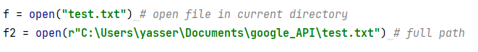
Text File Processing
Built-in function open (file_name, mode=‘r’, encoding=None,…)
opens a file.
1st argument: file name as string
2nd argument: open-file mode as string
3rd argument: encoding (platform dependent)
UTF-8 is recommended
Appending a ‘b’ to mode opens a file in a binary mode
E.g., mode=‘rb’
Mode | description
‘r’ | Reading only (default)
‘w’ | Writing only (delete existing content)
‘a’ | Appending text
‘r+’ | Reading and writing

Slide 7
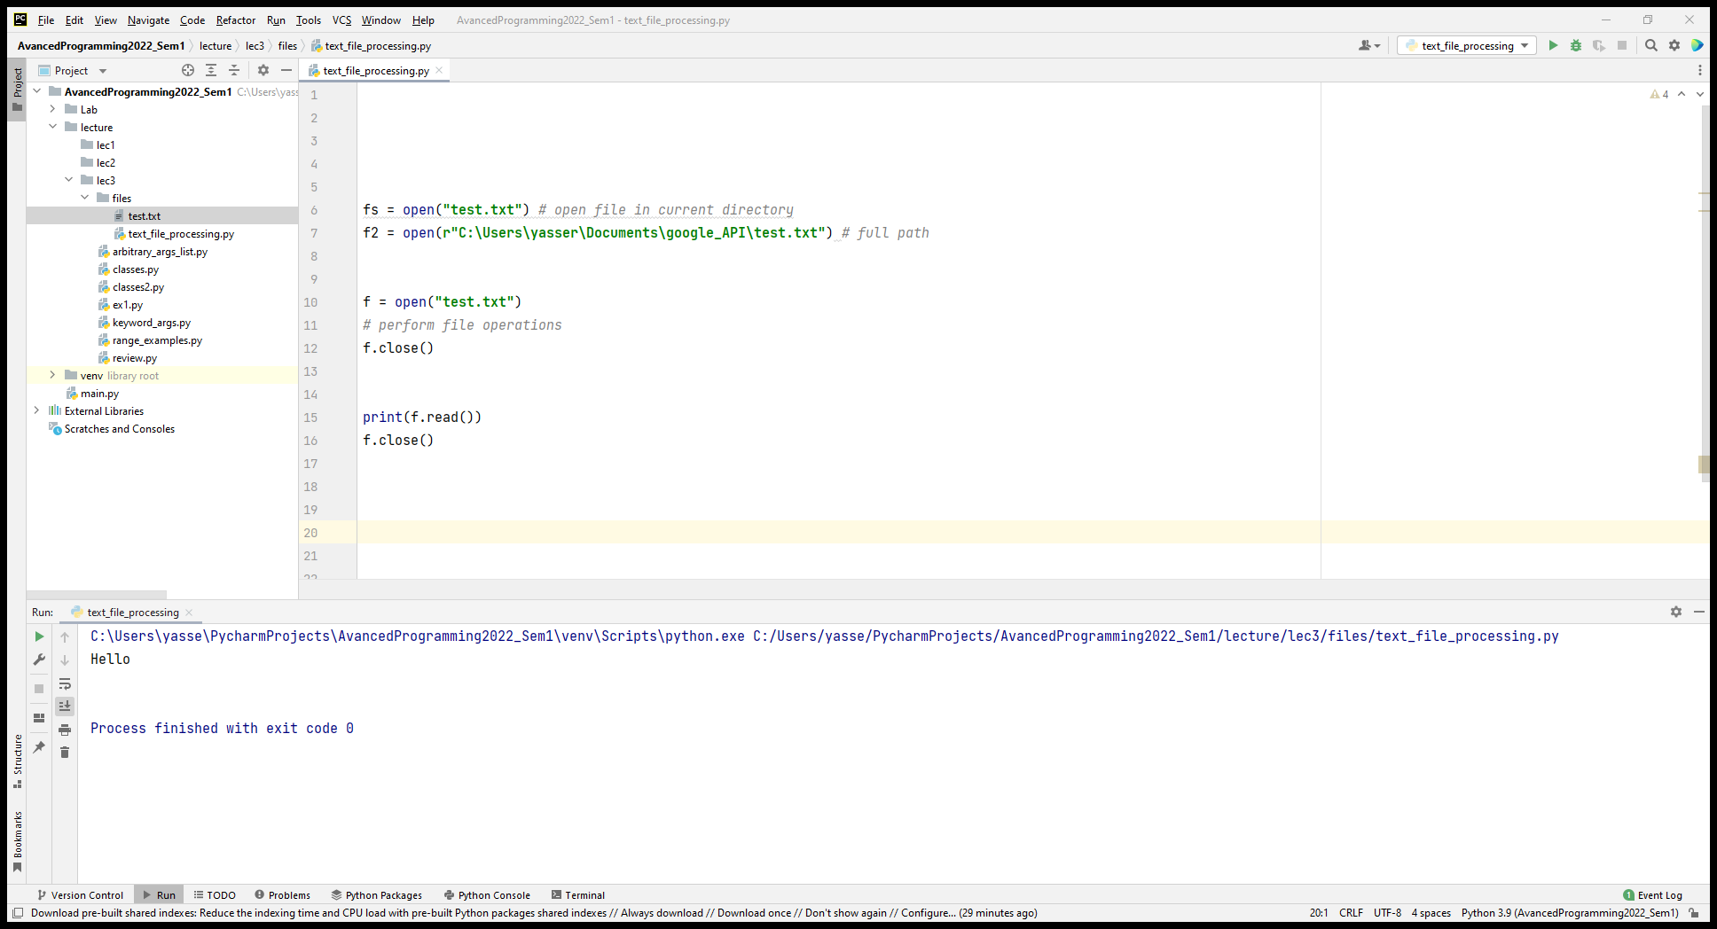
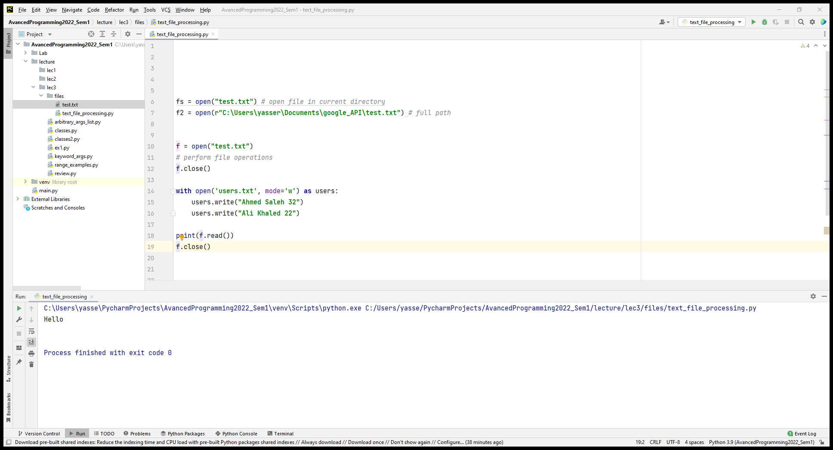
The with statement
Closing files is required to free up resources related to files
In Python close() method closes the file.
It is good practice to use the with statement when dealing with file objects. It properly and implicitly closes the file after reaching the end of with statement.

Slide 8
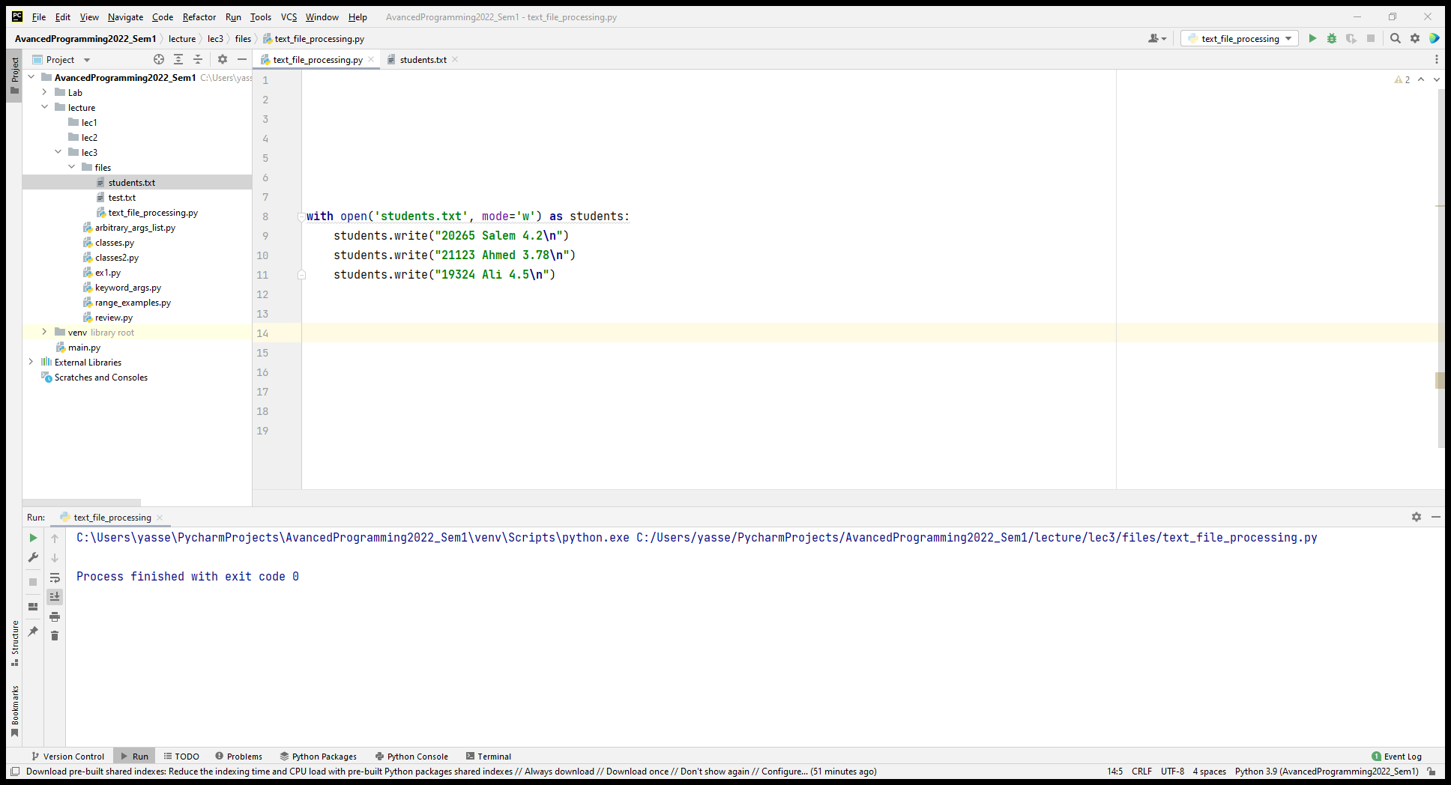
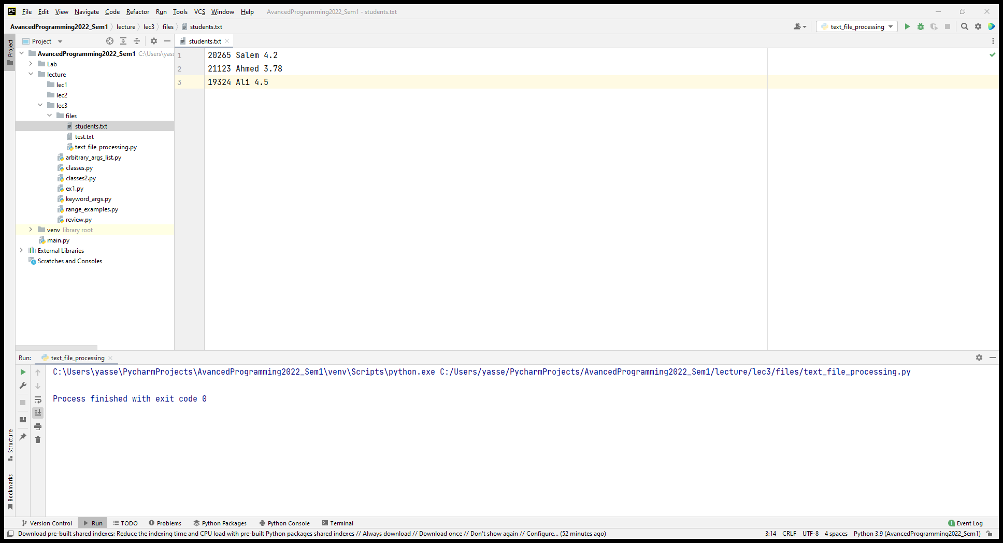
Writing to Text Files
write() method for the file object writes to files
Assume students' records (id, name, GPA) as follows
20265 Salem 4.2
21123 Ahmed 3.78
19324 Ali 4.5
Also, print can write to a file:
Note: print automatically outputs \n
print("20265 Salem 4.2", file=students)

Slide 9
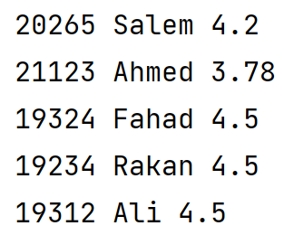
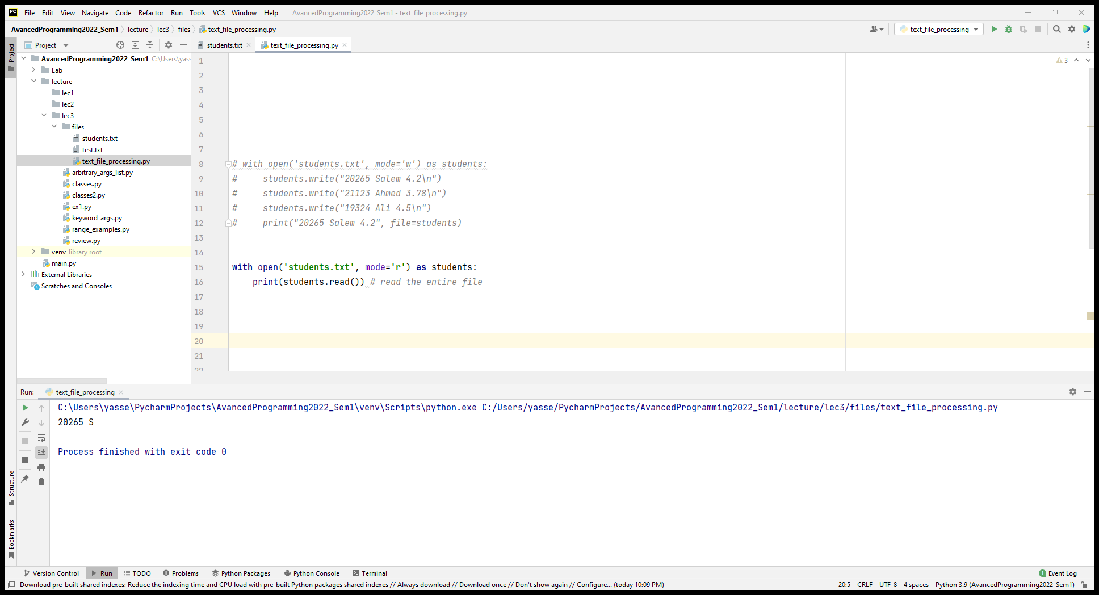
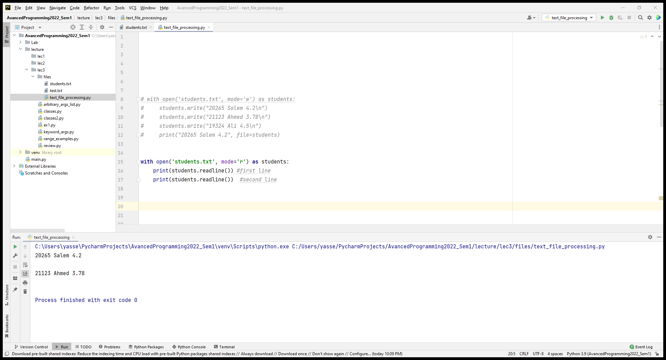

Reading Files
There are different ways to read data from files
read(size) reads some quantity (size) of data
Size is optional. If omitted, the entire file will be read.
readline() reads a single line from the file
students.readline()

Slide 10
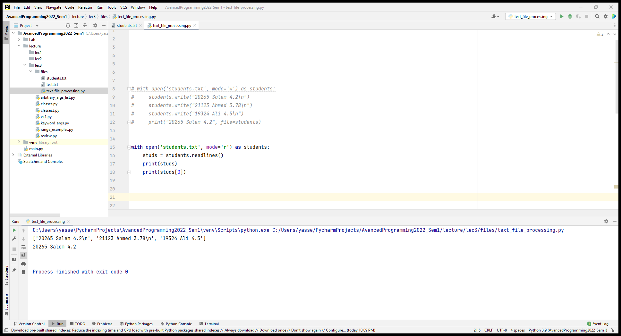
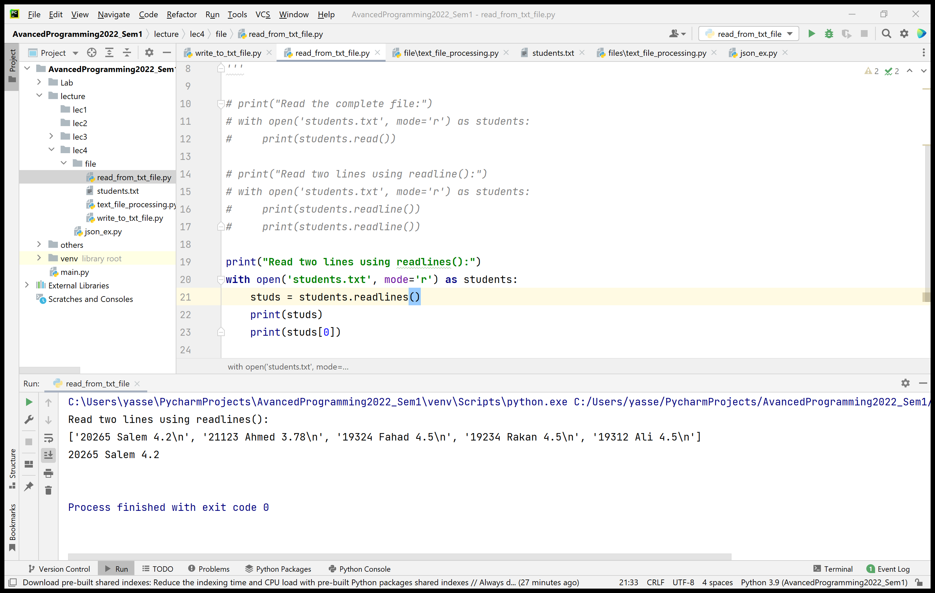
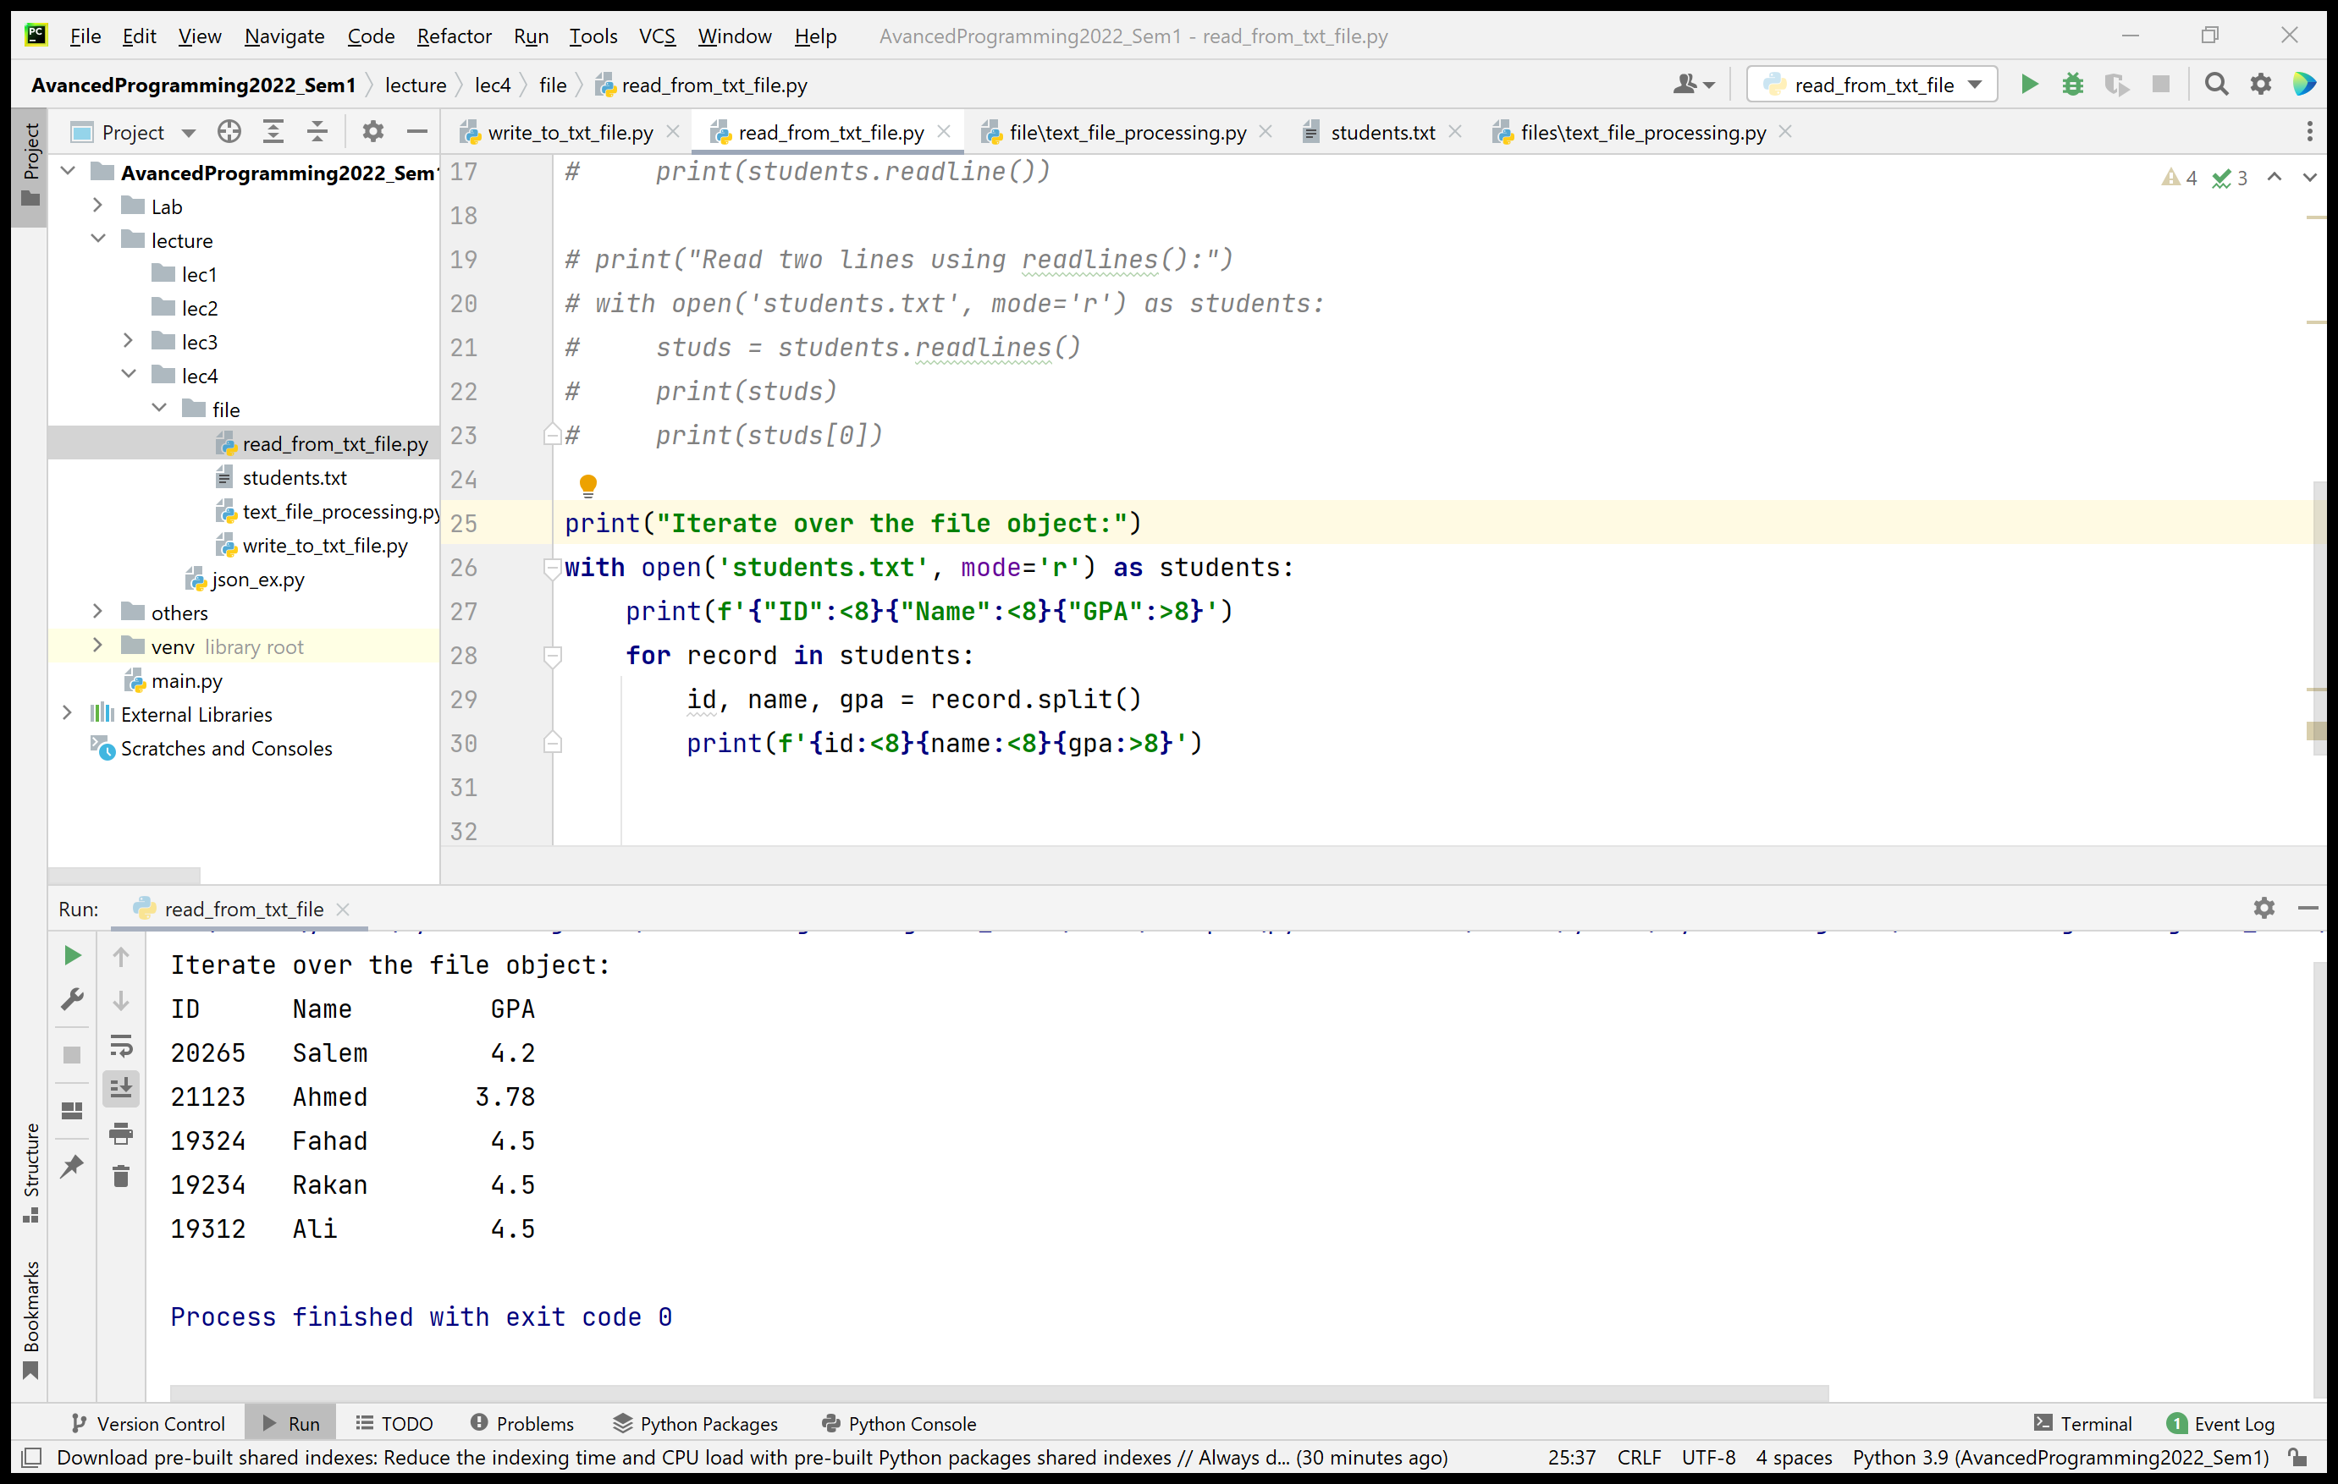
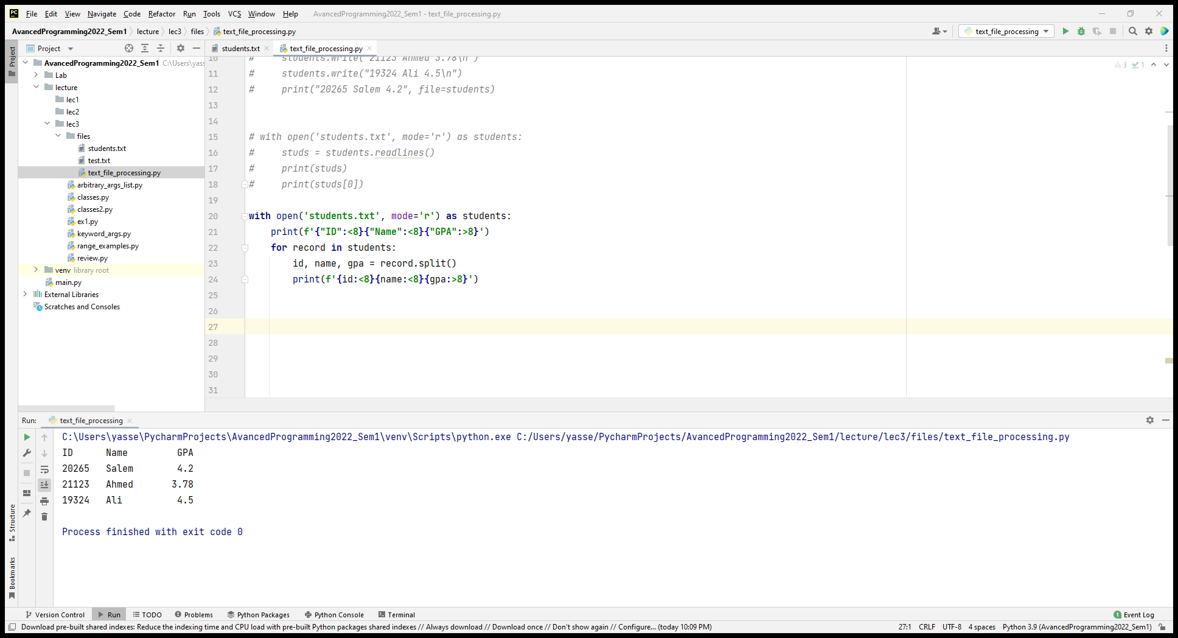
Reading Files
readlines() returns a list of lines from the file.
Iterating over the file object.
This is memory efficient, fast, and leads to simple code

Slide 11
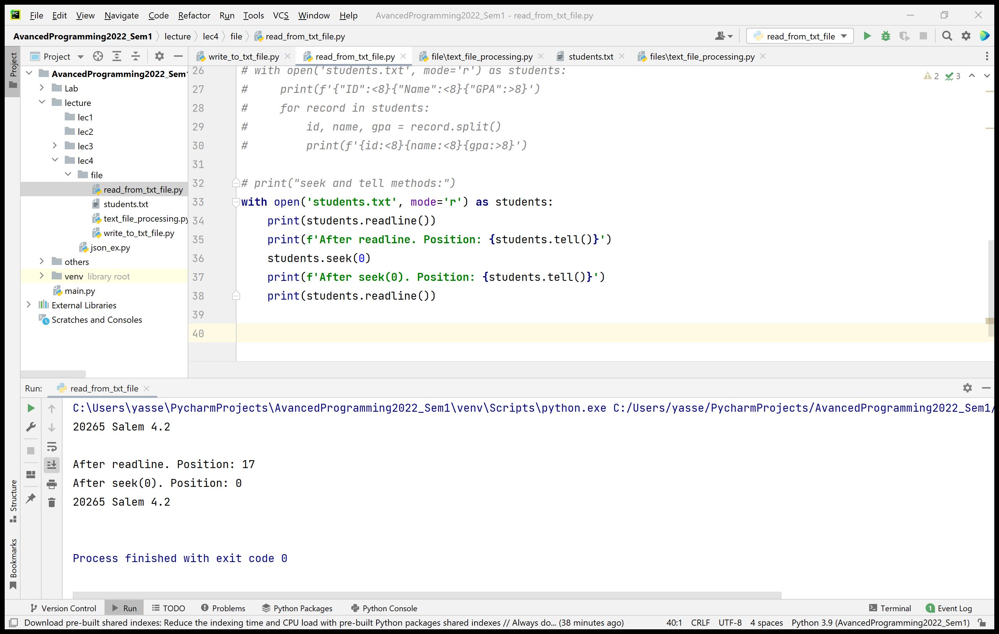
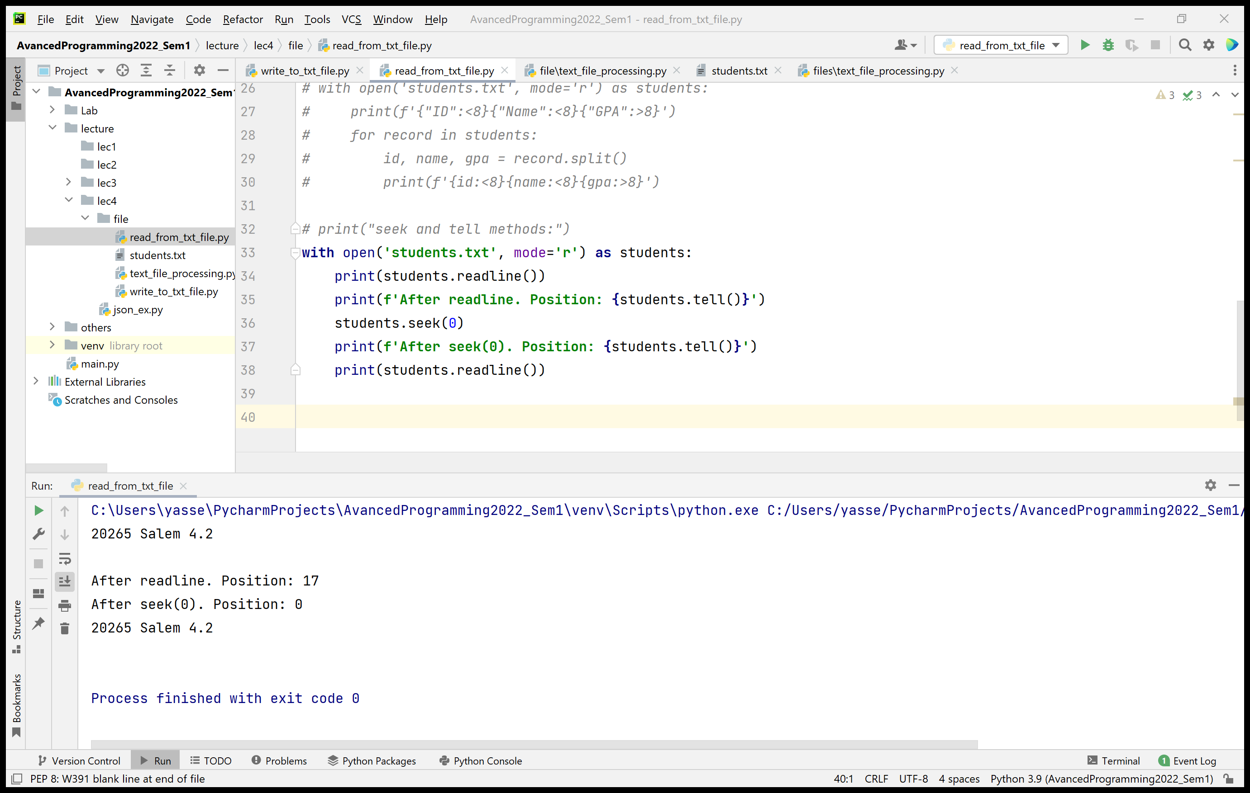
Reading Files – Useful File Methods
method seek(offset) changes the file position to offset bytes
E.g., students.seek(0) returns file position to the beginning of the file
method tell() returns an integer giving the file object’s current position in the file

Slide 12
Updating Text Files
If the name “Ahmed" must be changed to "Suliman" in students.txt, the old name can’t simply be overwritten.
21123 Ahmed 3.78
21123 Suliman.78 #after the name is overwritten
To make the change in a name:
Create a new temporary file
Copy records before the target records
Write the updated record
Copy records after the target records
Delete the old file
Rename the temporary file to use the original file’s name

Slide 13
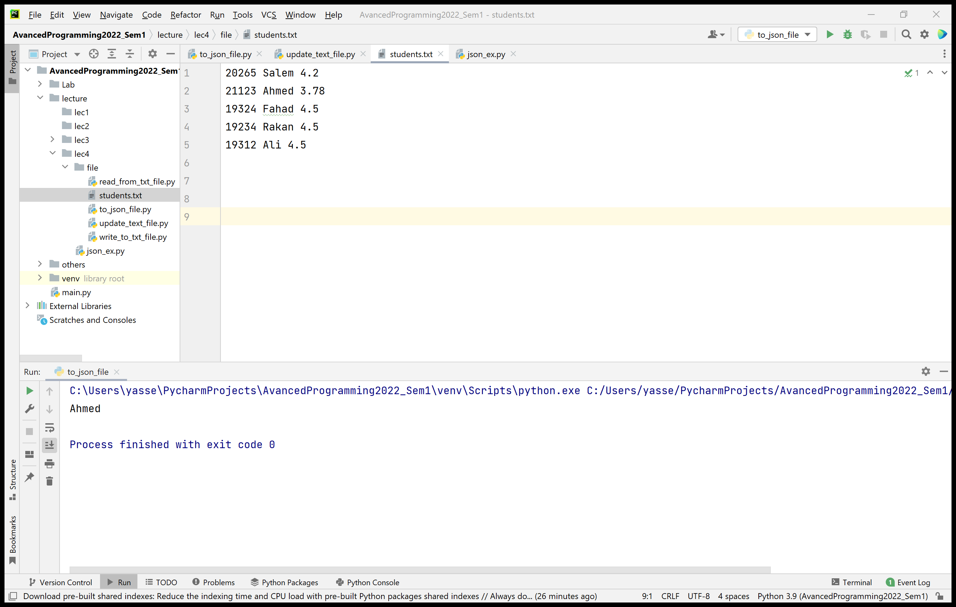
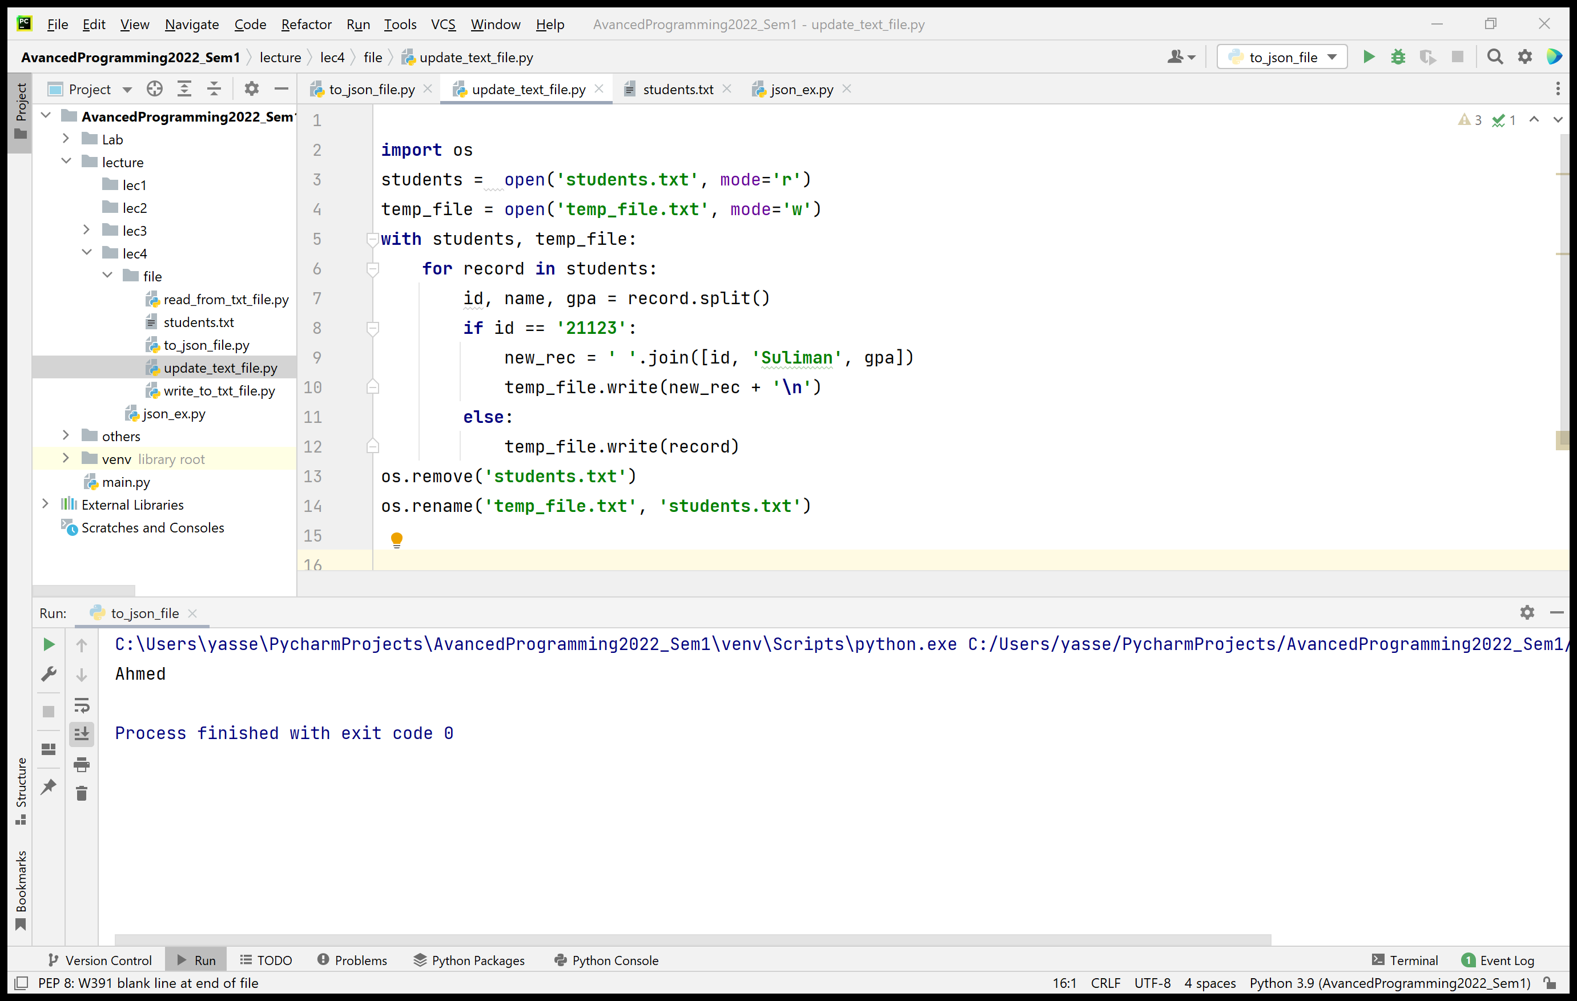
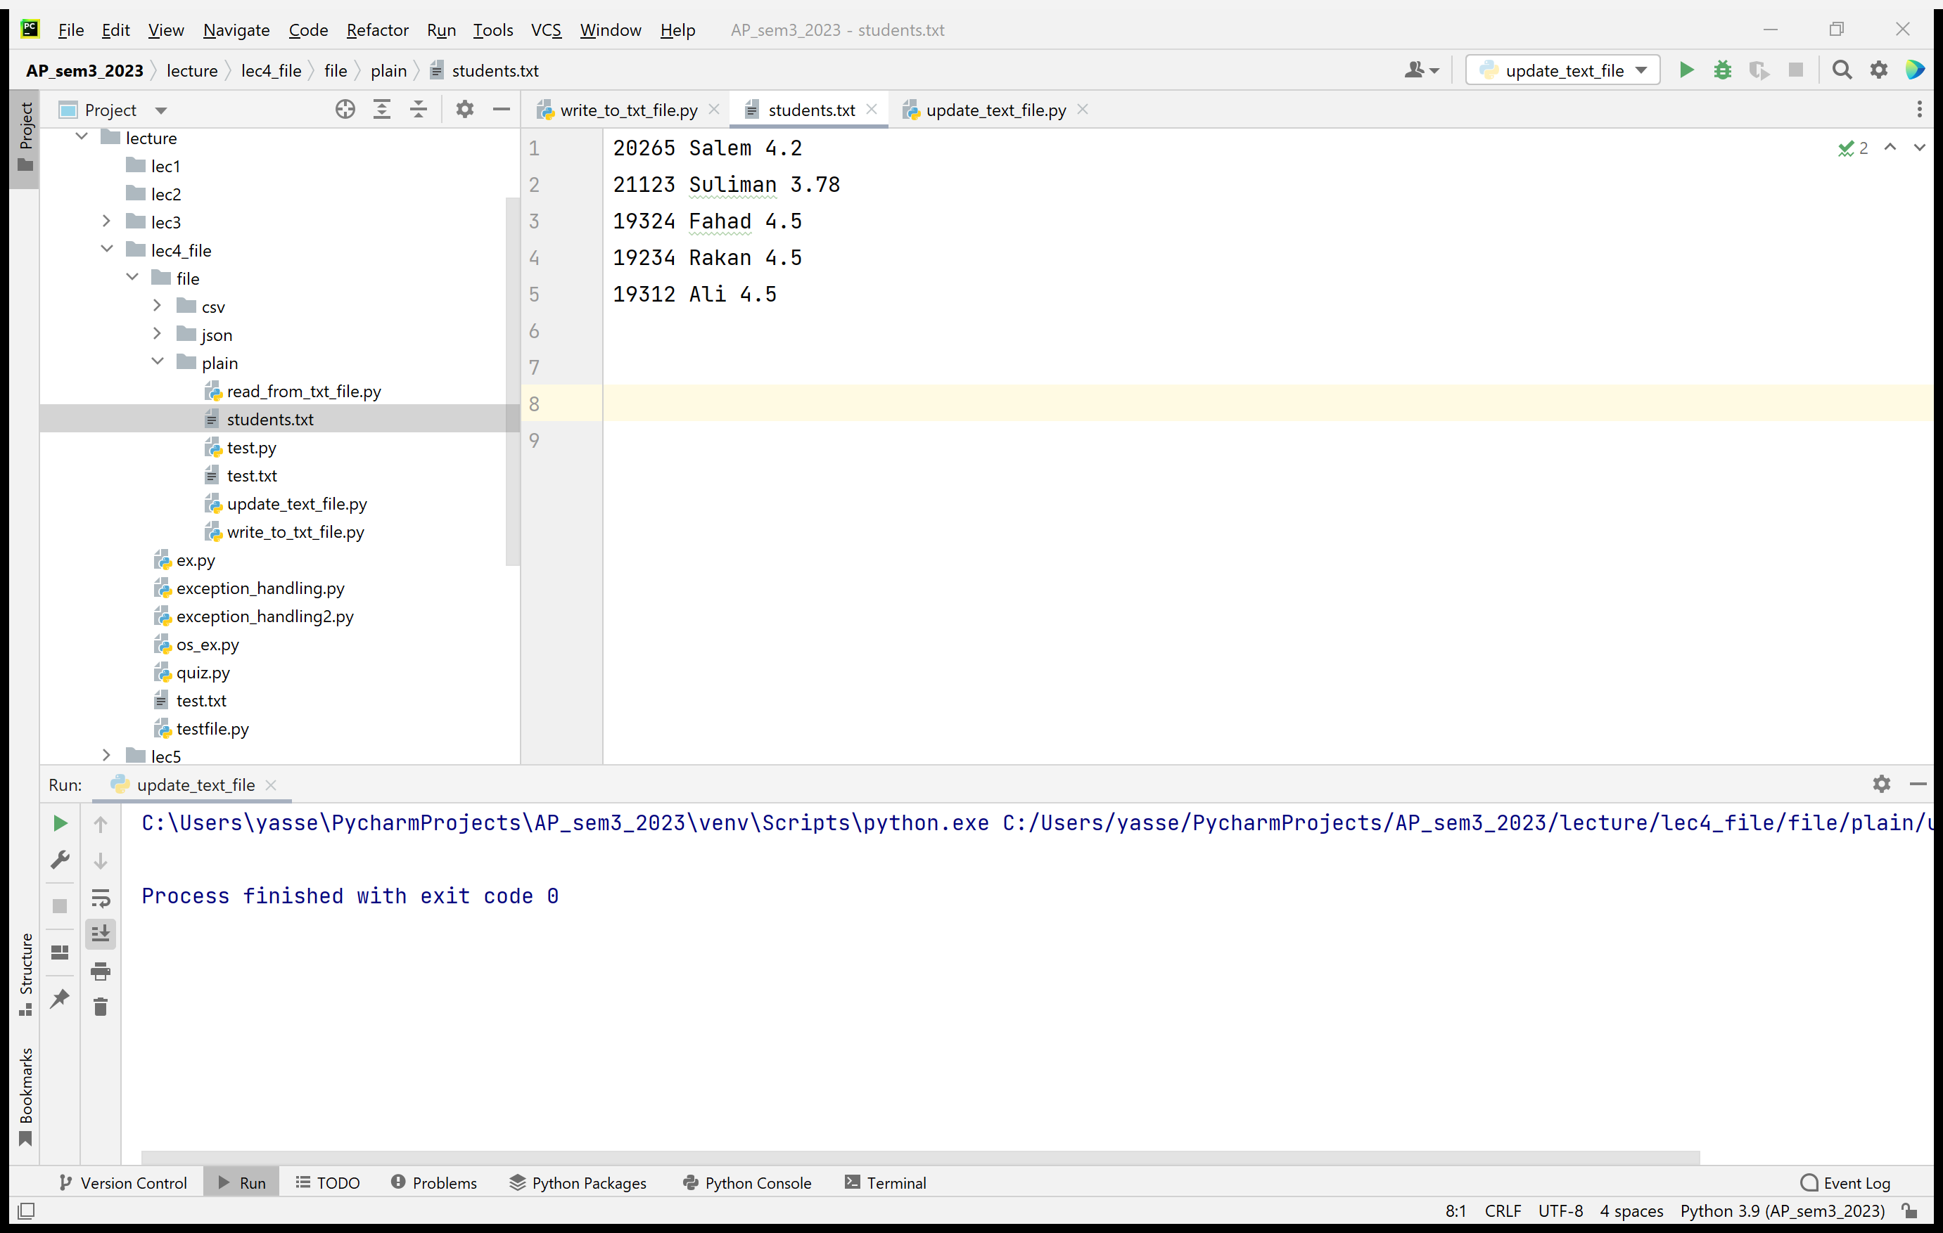
Updating Text Files

Slide 14
os and os.path modules
os module provides functions that interact with the operating system.
os.path module provides functions on pathnames.
Function | description
os.path.exists(path) | Return True if path refers to an existing path or an open file descriptor.
os.path.isfile(path) | Return True if path is an existing regular file.
os.path.isdir(path) | Return True if path is an existing directory.
os.path.join(path, *paths) | Join one or more path components intelligently.
https://docs.python.org/3/library/os.path.html

Slide 15
os and os.path modules
Function | Description
os.listdir(path) | Return a list containing names of the entries in the directory given by path.
os.mkdir(path) | Create a directory named path with numeric mode mode.
os.remove(path) | Remove (delete) the file path.
os.rename(src, dst) | Rename the file or directory src to dst.
os.rmdir(path) | Remove (delete) the directory path.
https://docs.python.org/3/library/os.html

Slide 16
Serialization with JSON

Slide 17

JSON (JavaScript Object Notation)
Your application can interact with cloud-based services, such as X (Twitter), Instagram, via JSON objects.
JSON (JavaScript Object Notation) is a text-based, human-readable data-interchange format
It is used to represent objects, e.g., dictionaries, lists, as collections of name-value pairs.
It has become the preferred data format for sending object across different platforms.

Slide 18
JSON Data Format
JSON objects are like Python dictionaries
Each JSON object contains a comma separated property names:values in {}
E.g., {"account":200, "name": "Fahad", "balance": 75.63}
Also, JSON supports arrays, like Python lists, e.g., [3, 5, 3, 5]
Values in JSON objects and arrays:
string in " " e.g., " Yasser Aldwyan“
numbers e.g., 23, 4.5
JSON Boolean values: true/false
Null (mean no value, similar to None in Python)
Arrays: [4, 5, 7]
Other JSON objects

Slide 19
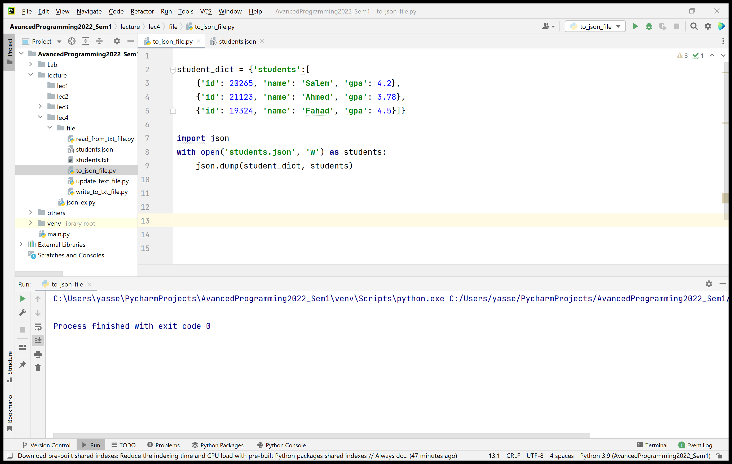

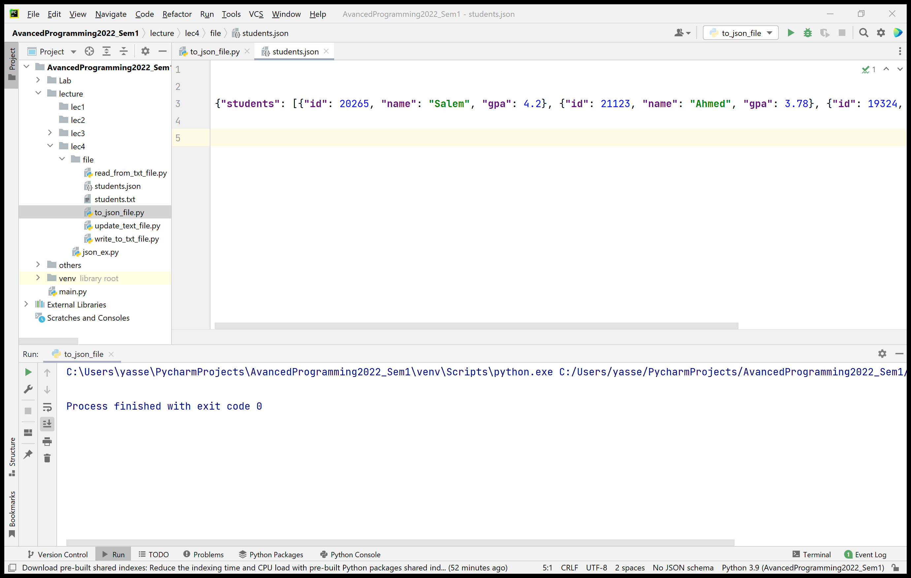
Python Standard Library Module json
Serializing an Object to JSON
json module can convert objects to JSON text format
Use dump function to serialize data into a file

Slide 20
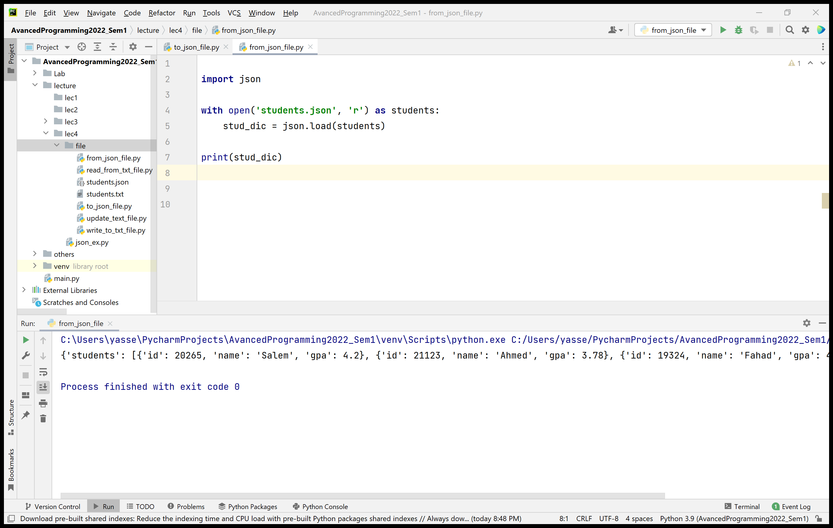
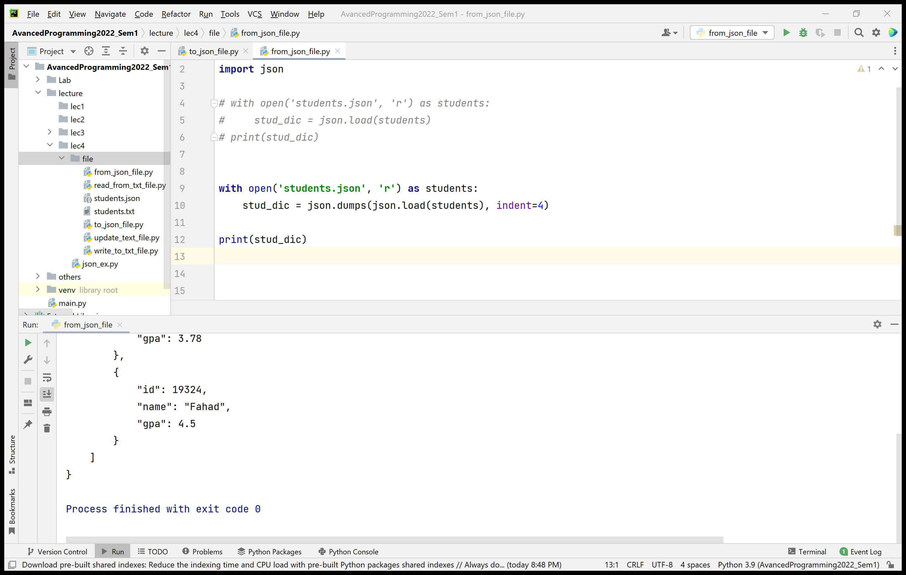
Python Standard Library Module json
Deserializing the JSON text
Use load function converts JSON contents into a Python object.
Displaying the JSON text
Use dumps (short for dump string) returns a Python string representation of an object in JSON format.
dumps with load can be used to read JSON from file and display it in a nicely indented format (pretty printing)

Slide 21
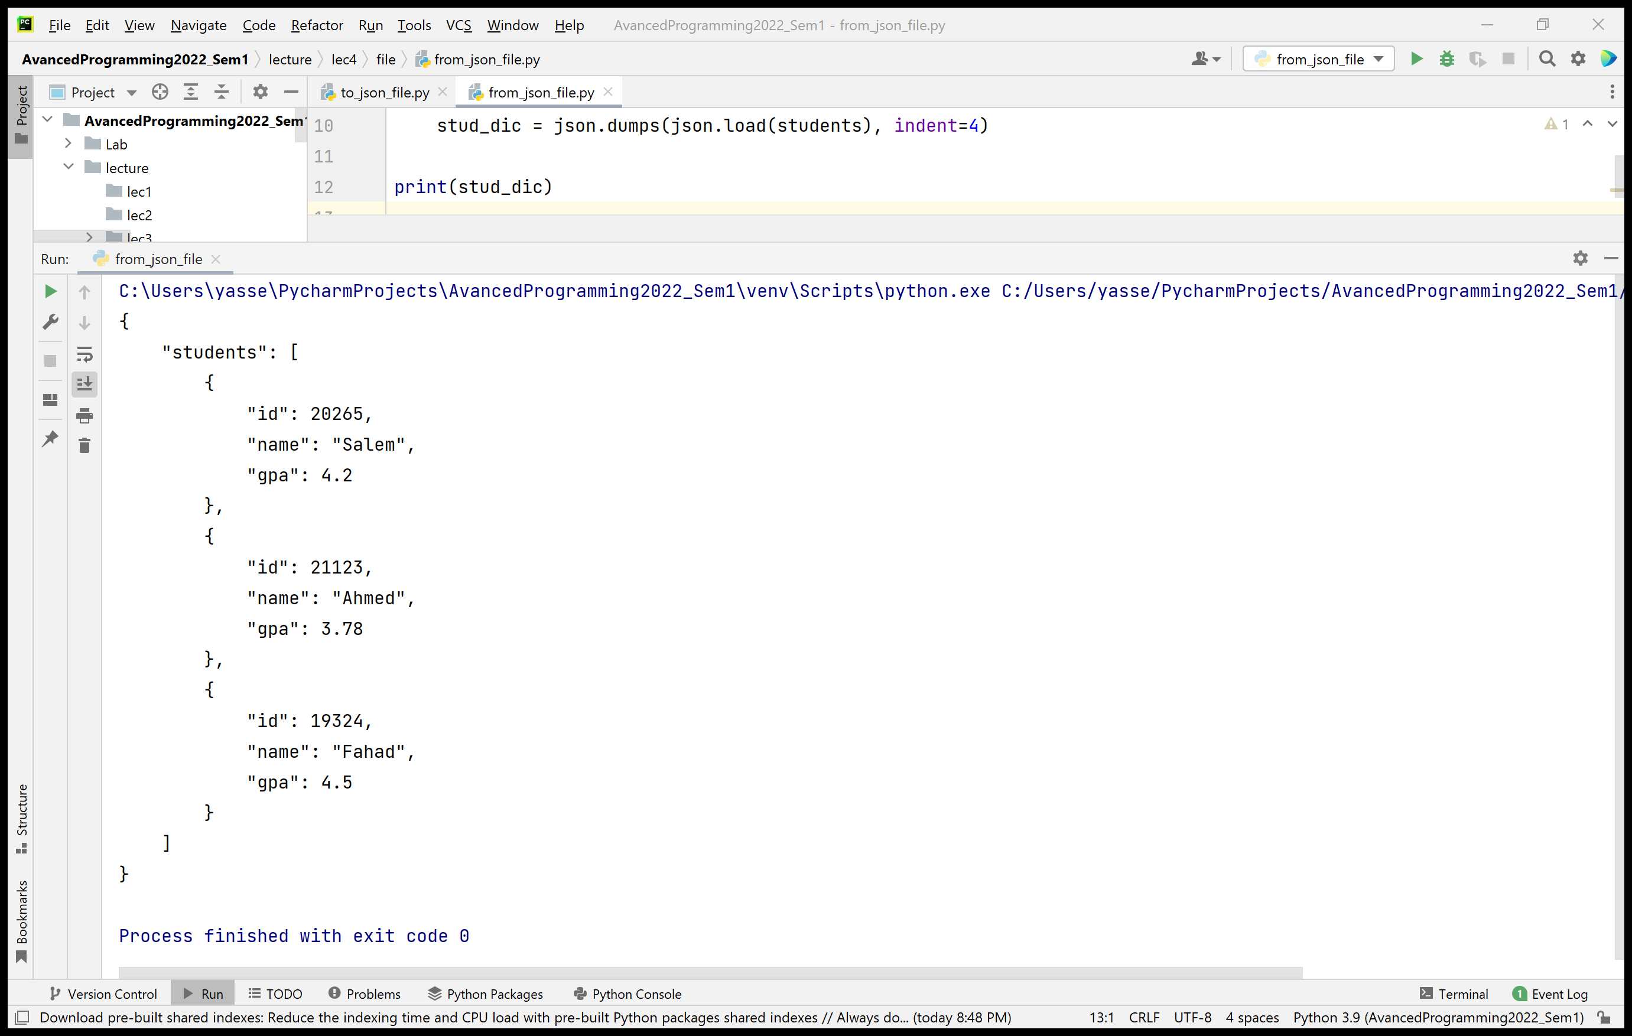
Python Standard Library Module json
Displaying the JSON text
The output

Slide 22
Working with CSV files
Comma-Separated Values (CSV): another popular text file format

Slide 23
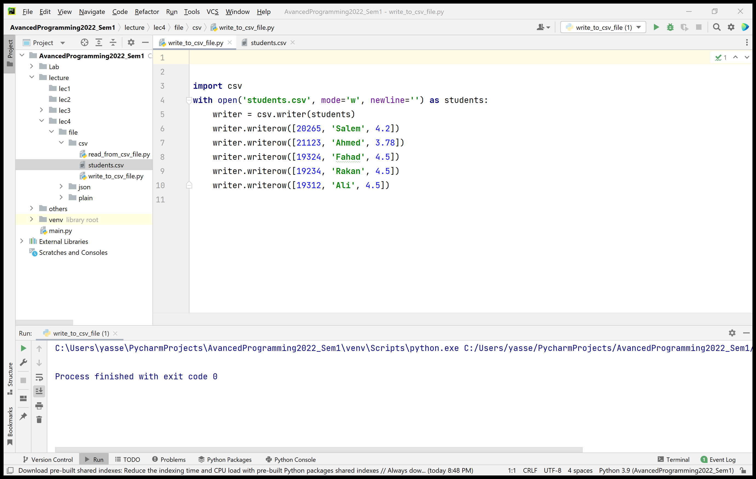
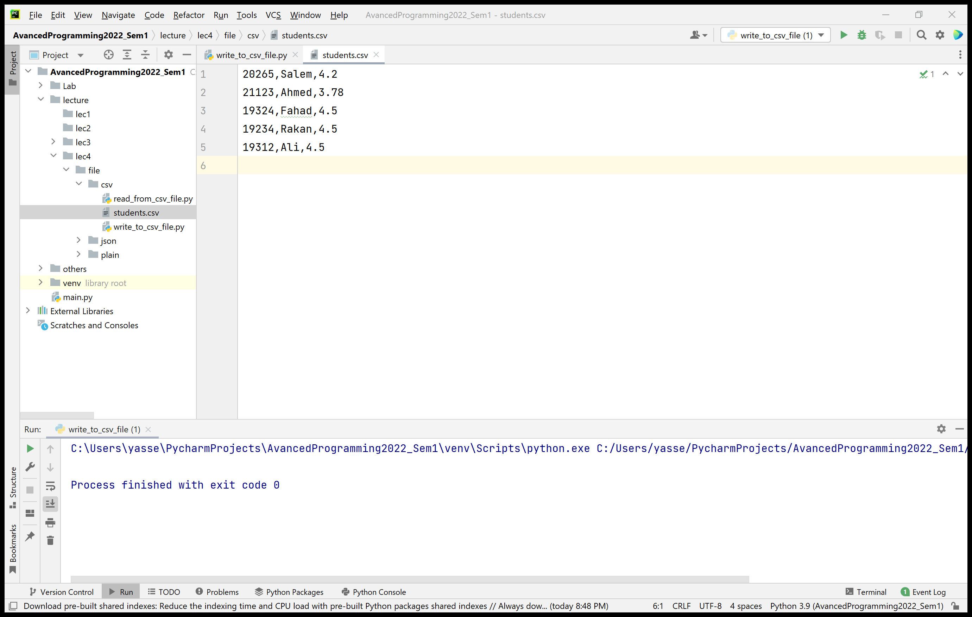
Writing to CSV Files
csv module provides functions for dealing with CSV files.
To write to a CSV file:
Open a file with open function. It is recommended to open with newline= ' '
writer()returns an object that writes CSV data to specified file object
writer has writerow method which takes an iterable to store to the file.

Slide 24
Writing to CSV Files
When writing data that contains commas within a given string, writerow encloses that string in double quotes
E.g., [22756, ‘Alharbi, Yasser’, 3.75]
writerow writes like 22756, “Alharbi, Yasser”, 3.75
The quotes around “Alharbi, Yasser” indicates that this is a single value

Slide 25
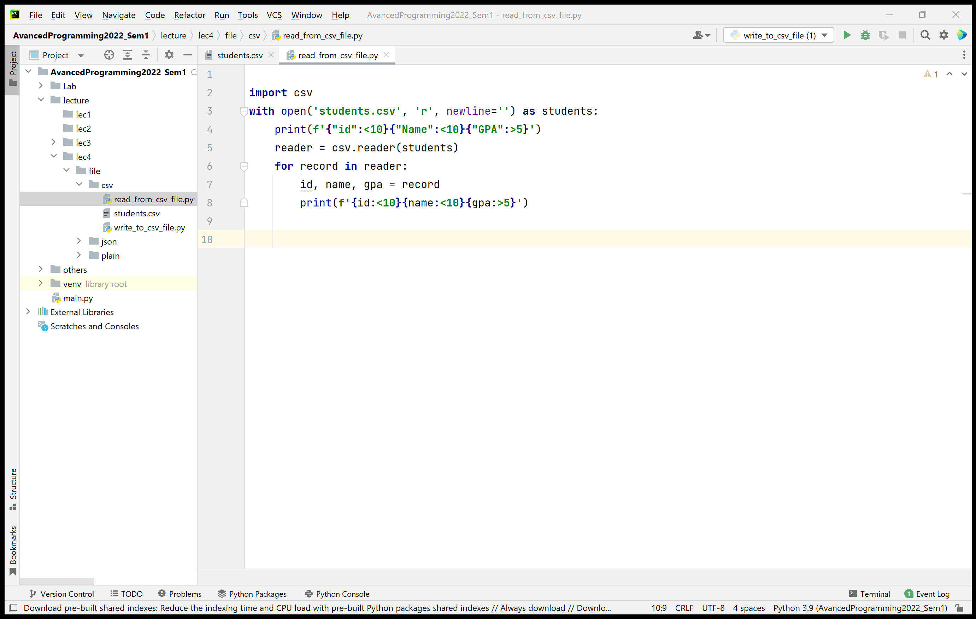
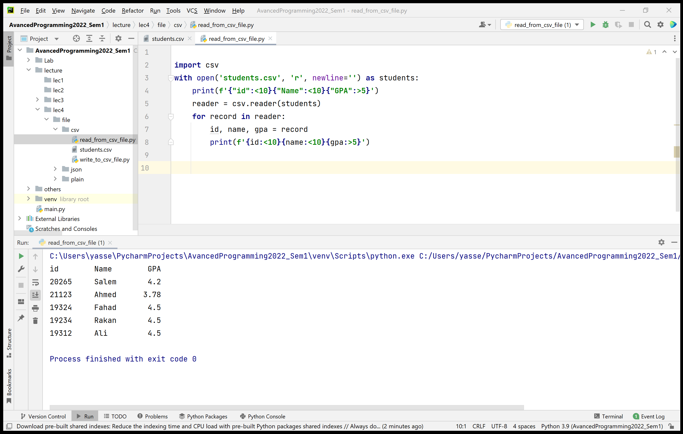
Reading from CSV Files
reader function returns an object that reads CSV-format data from specified file object.
Then, iterate through the reader object one record of comma-delimited values at a time.

Slide 26
Exception Handling

Slide 27
Handling Exceptions
An exception indicates problems during execution time of a program.
Examples of exceptions: ZeroDivisionError, NameError, ValueError, TypeError, RuntimeError, etc.
We will see how to handle exceptions to enable code to continue processing

Slide 28
Handling Exceptions - Syntax
try: #statements that might raise exceptions except error_type: #one or more except clauses #statements else: #executes if no exceptions occur #statements finally: #always executed #statements

Slide 29
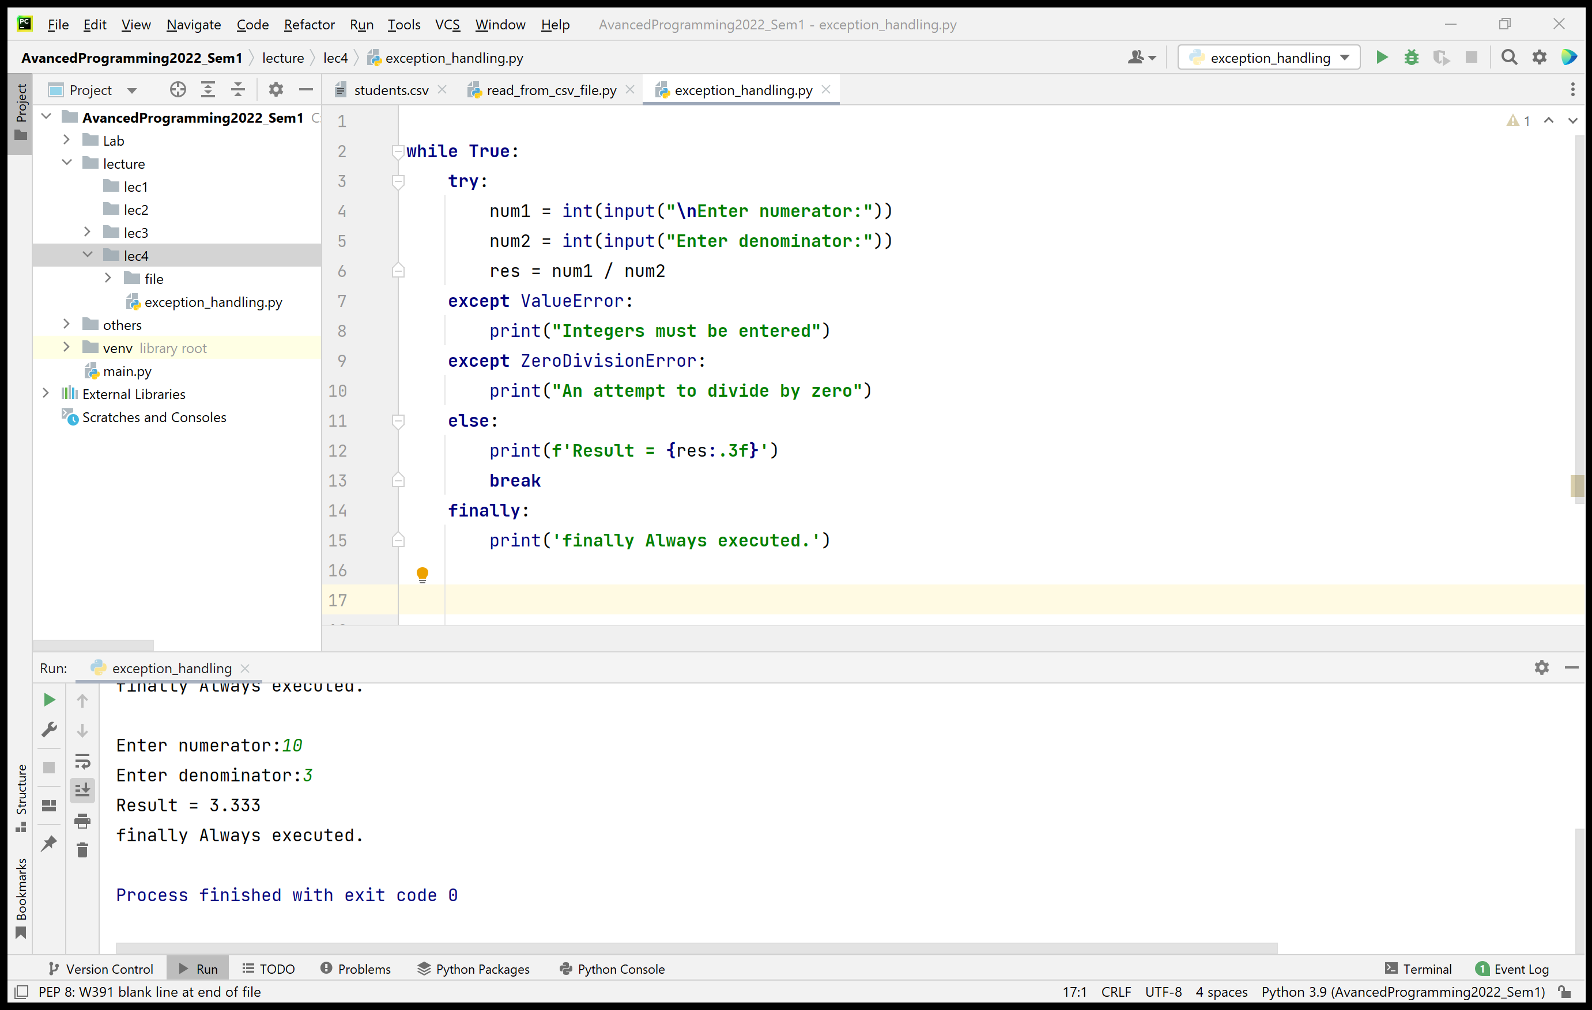
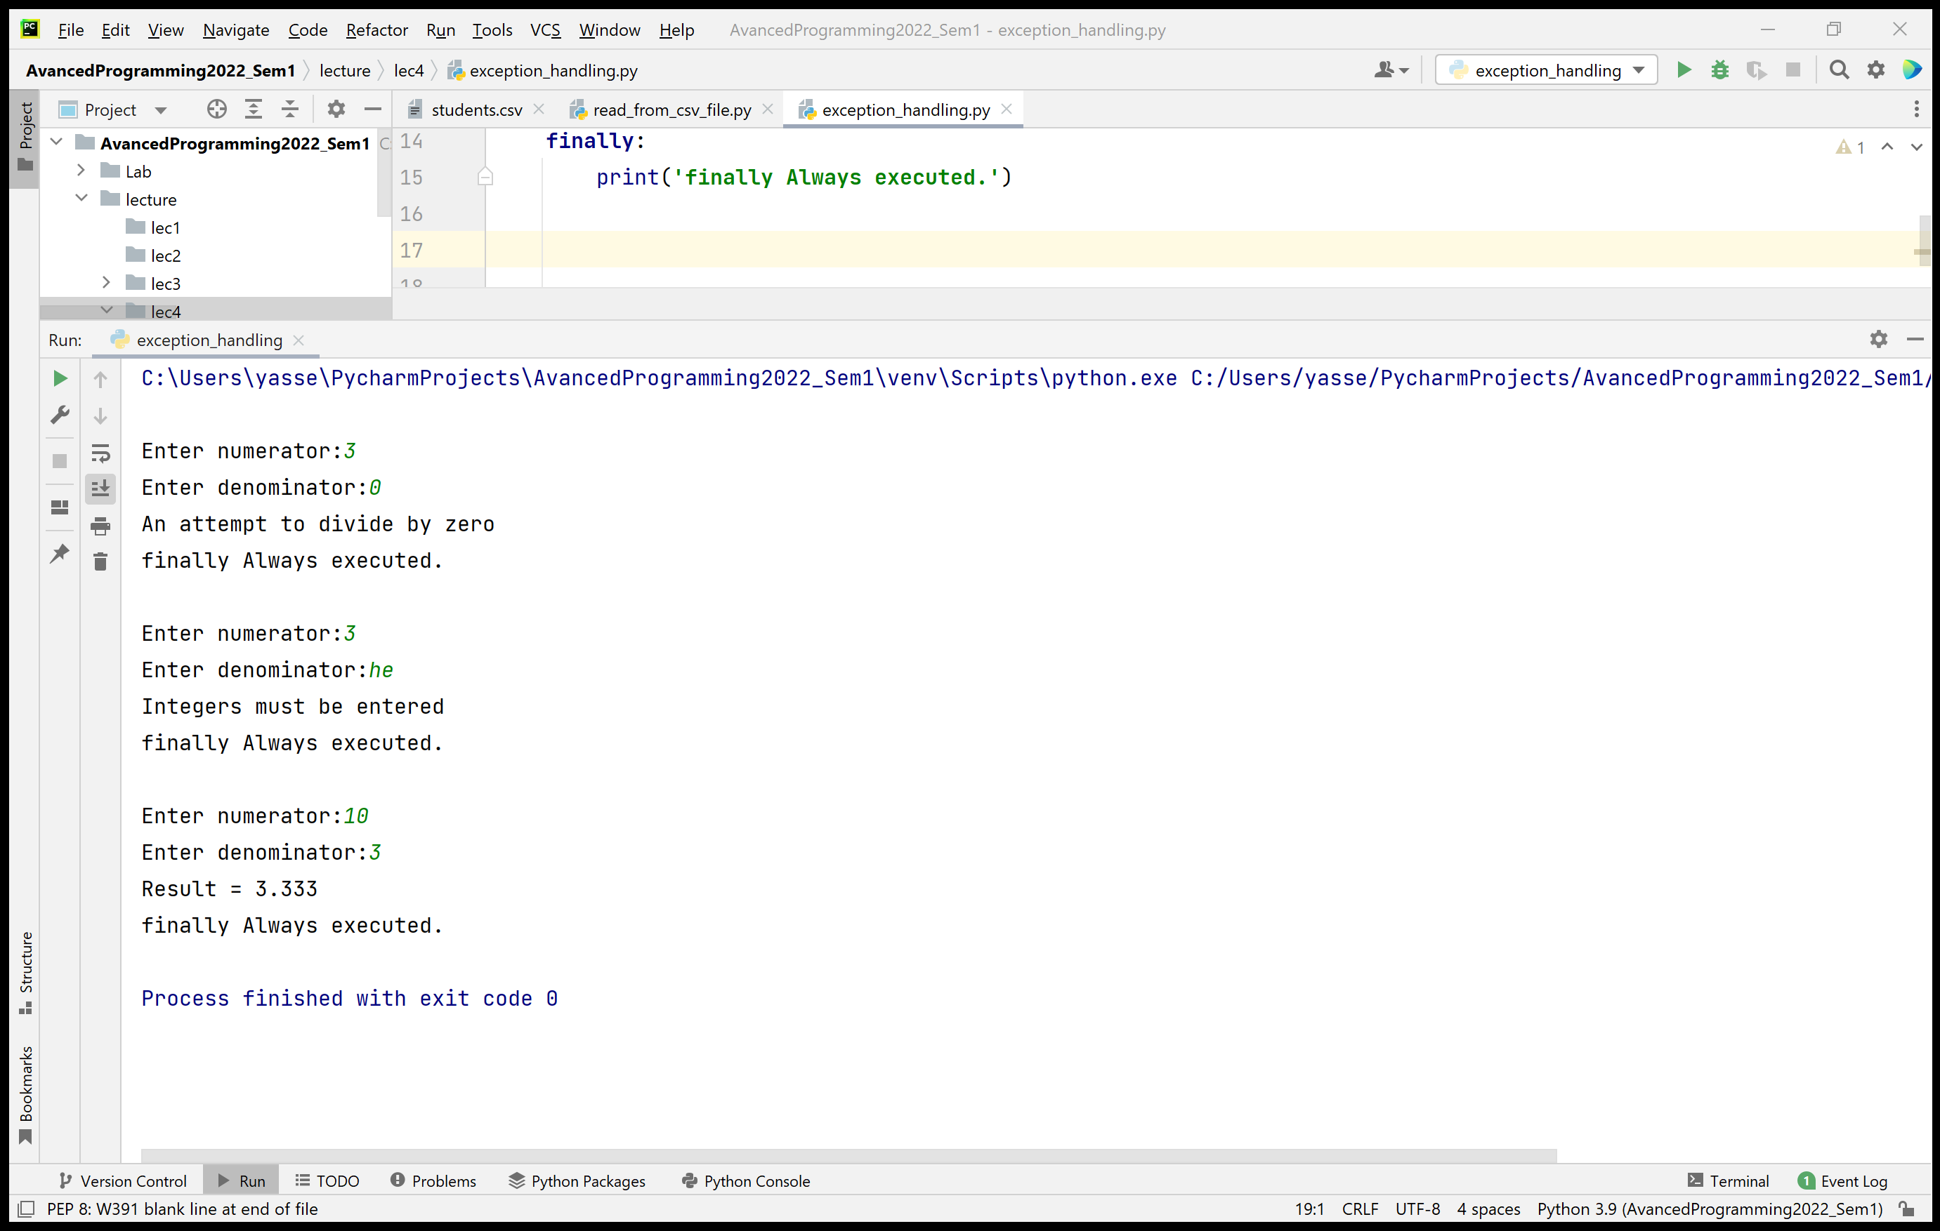
Handling Exceptions – An example

Slide 30
Handling Exceptions - Syntax
Catching multiple exceptions in one except clause
except (type1, type2, …) as variable_name:
The as clause is optional
Explicitly raising an exception
raise ExceptionClassName
Creates an object of the specified exception class.

Slide 31
Thank you

